Slide 1
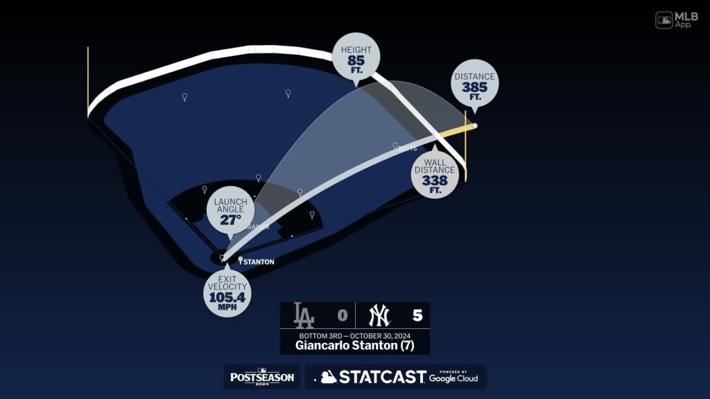
Using Statcast Data to Predict Home Run Outcomes
By: Graydon Bower

Slide 2
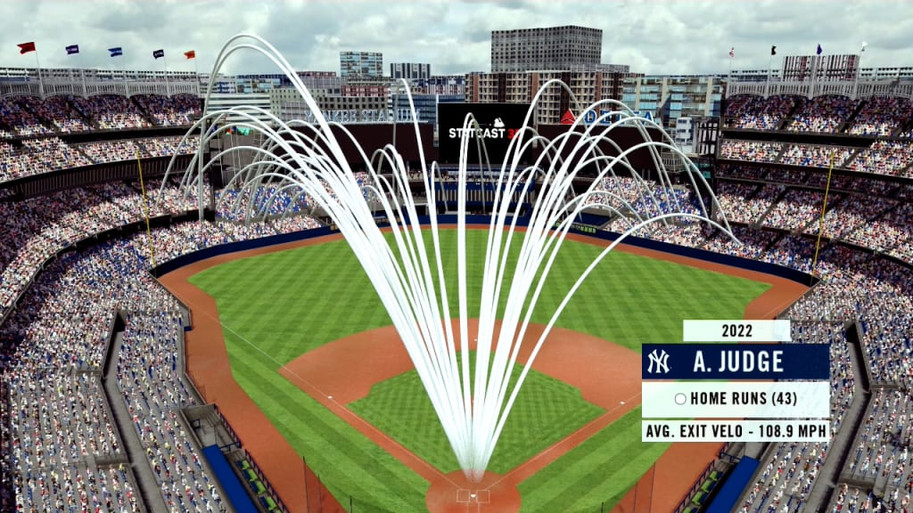
Introduction
Goal: Use features from Statcast dataset to differentiate between home runs and other hits
Used three different machine learning models
Logistic Regression
Decision Tree
Random Forest
Compared models to identify which one performed best
Based analysis of performance on TPR, PPV, f1_score, & AUC

Slide 3
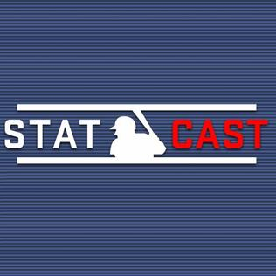
About the Dataset
Contains Statcast data for each event from each game of 2021 MLB season
Statcast = high-speed camera tracking technology used to collect and analyze data related to player performance and game events
Captures player movements and athletic ability and translates into data related to pitching, hitting, fielding and more
Ex: Zone, hit_location, bb_type, release_speed, launch_speed, hit_distance, etc.
Dataset included 93 columns and 709,851 rows worth of data

Slide 4
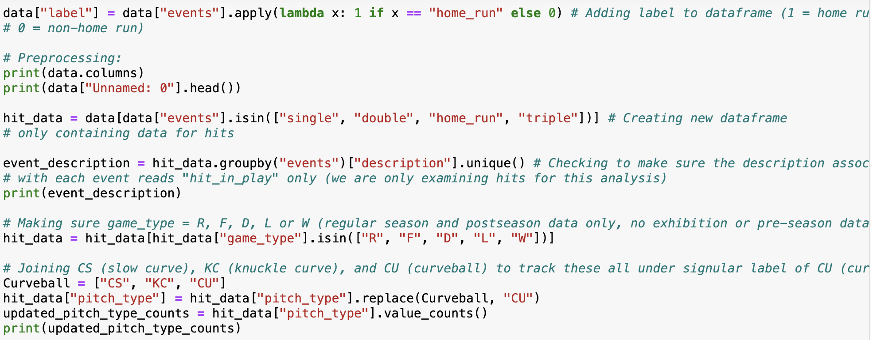
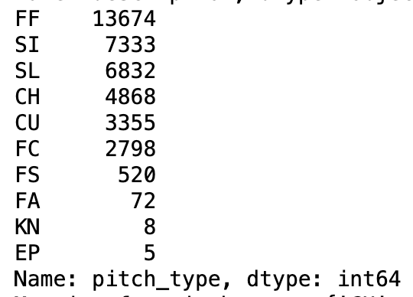
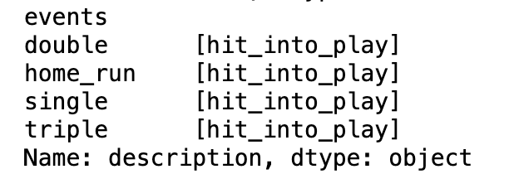
Preprocessing
Created class labels where 1 = home run event and 0 = each other event
Reduced dataset to examine only events which were hits (single, double, triple, home run)
Made sure description of event was “hit_in_play”
Made sure data used was regular season and playoff data (no exhibition or pre-season games included)
For pitch_type feature, joined CS (slow curve), KC (knuckle curve), and CU (curveball) together as CU (all just different types of curveball)

Slide 5
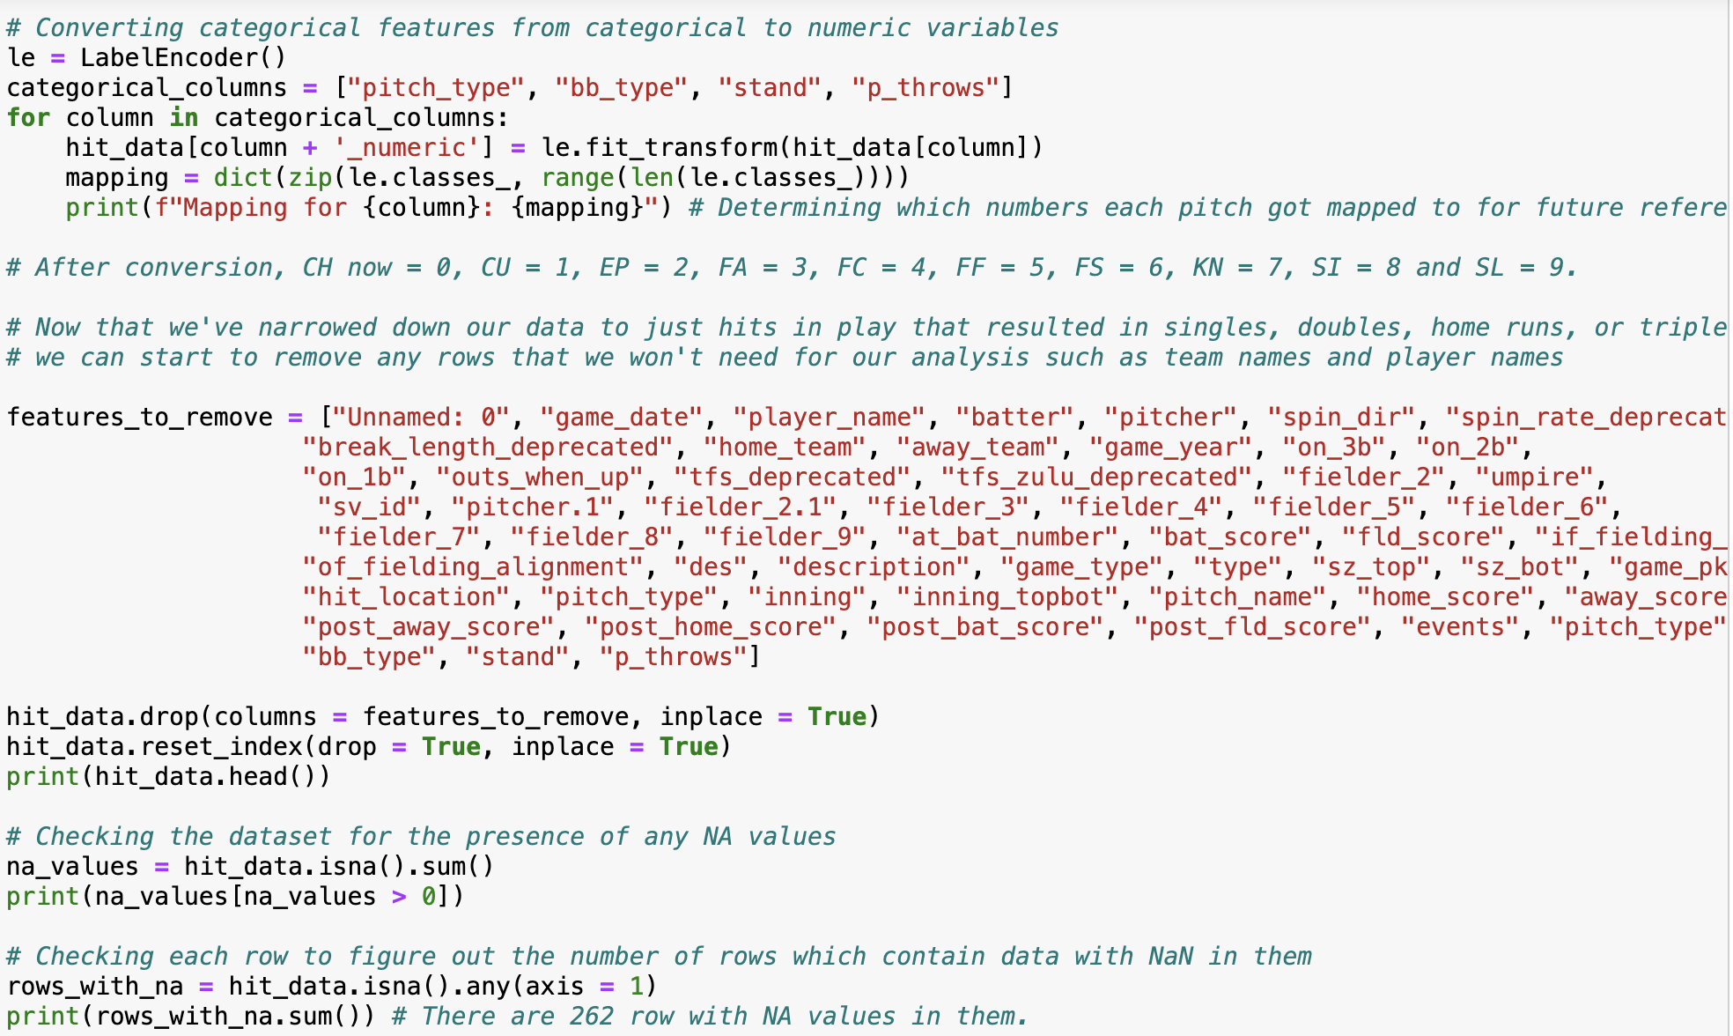
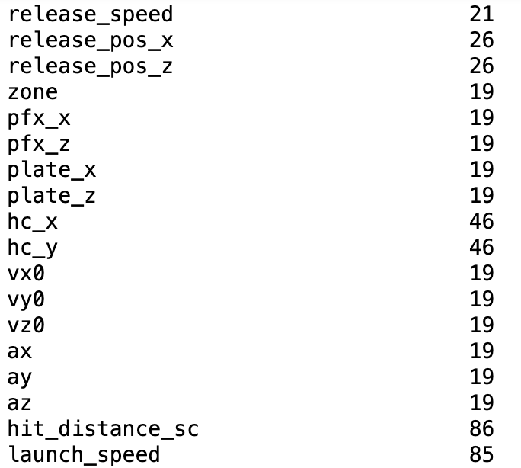
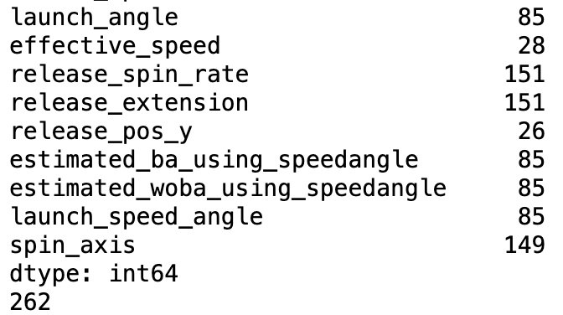
Preprocessing Cont.
Converted categorical features into numeric features and printed mapping for reference
Removed features with no bearing on analysis
Checked dataset for rows with NA values
Dropped rows with NA in them for hit_distance, pitch_type_numeric, zone, and hc_x
Used median value to replace NA values for release_spin_rate, release_extension, and spin_axis (no more NA values after these changes)

Slide 6
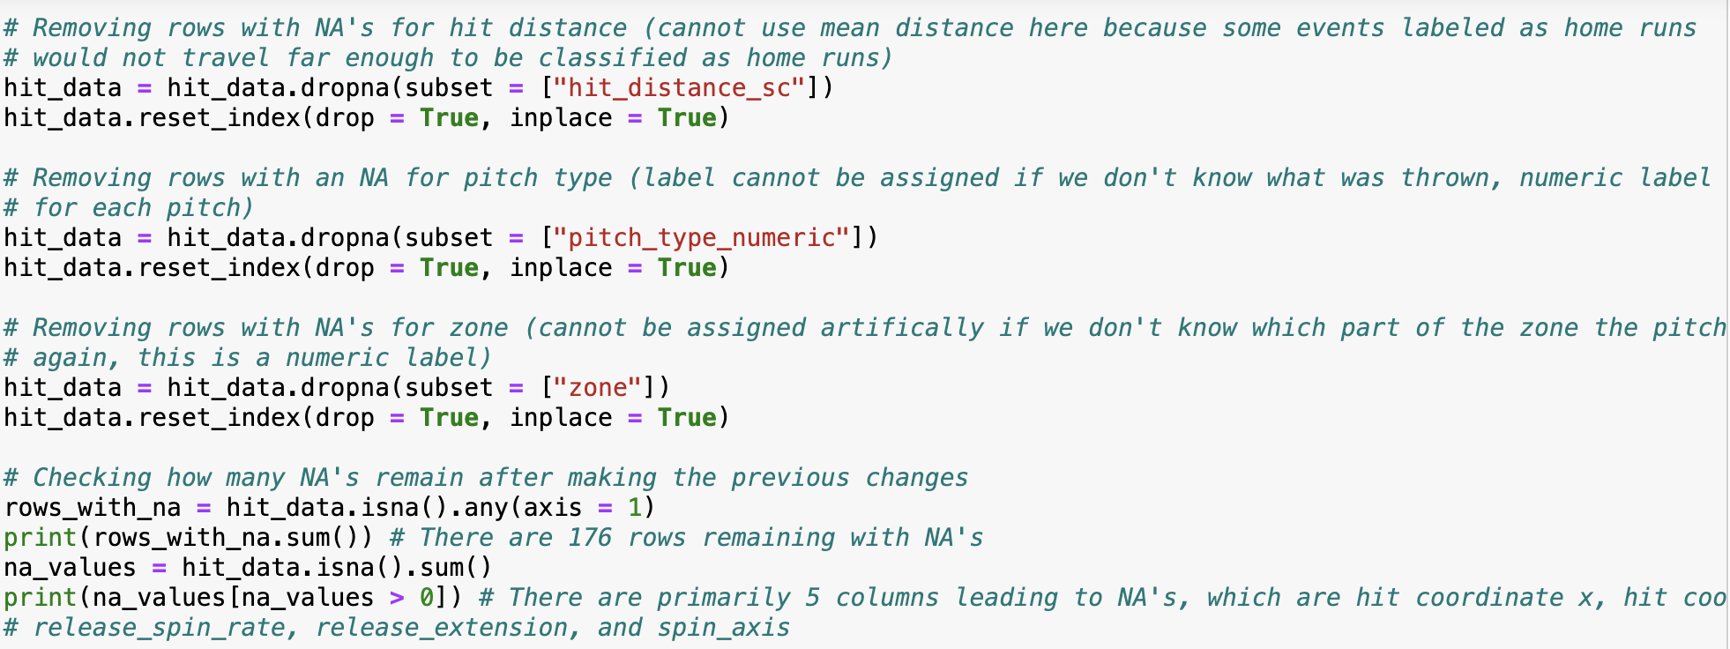
Code for Removing NA Values

Slide 7
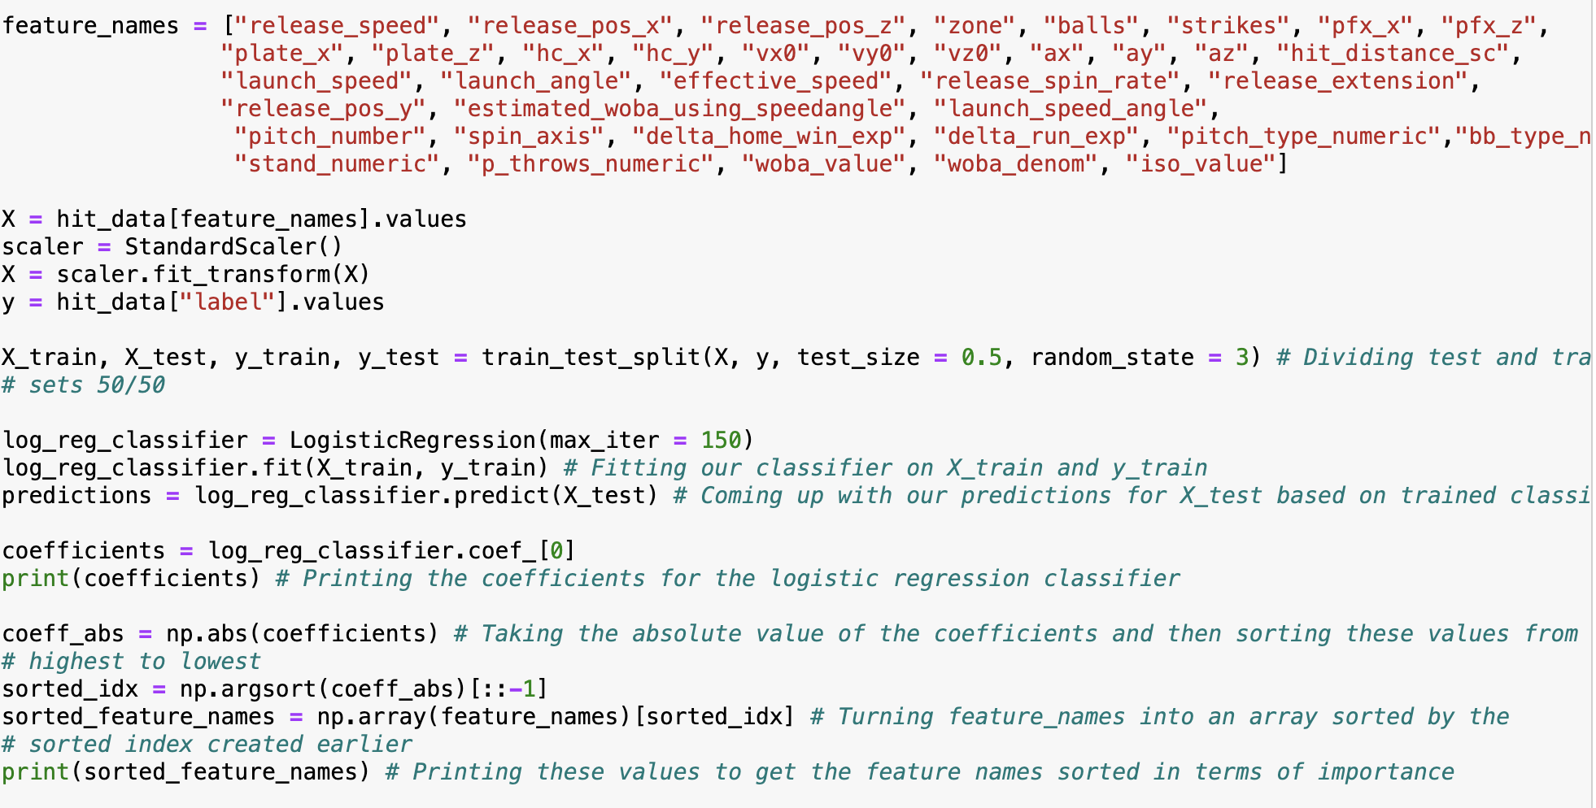
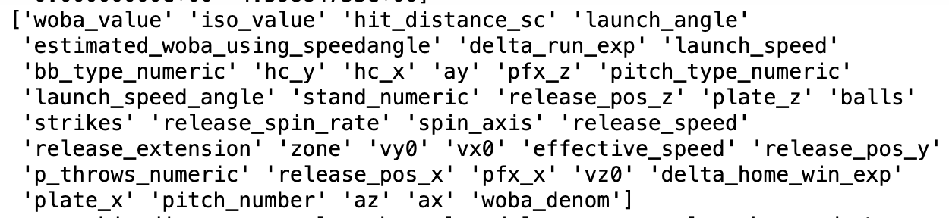
Determining Feature Importance
After preprocessing, still had 38 features which might have impact on identifying home runs
Ran Logistic Regression with scaled features to print beta coefficients (largest = most important, 2nd largest = 2nd most important, and so on)
Took absolute value of coefficients and sorted in descending order
Turned feature names into array sorted by absolute value of coefficients
Features in order of importance: hit_distance, launch_angle, delta_run_exp, launch_speed, bb_type, hc_y, hc_x, ay, pfx_z, pitch_type

Slide 8
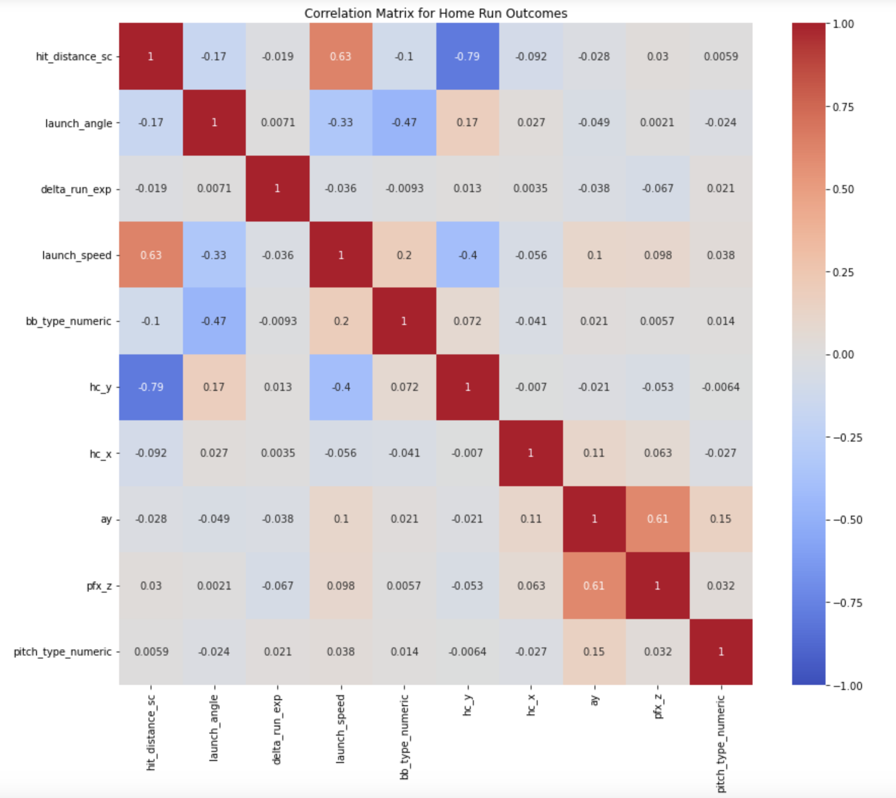
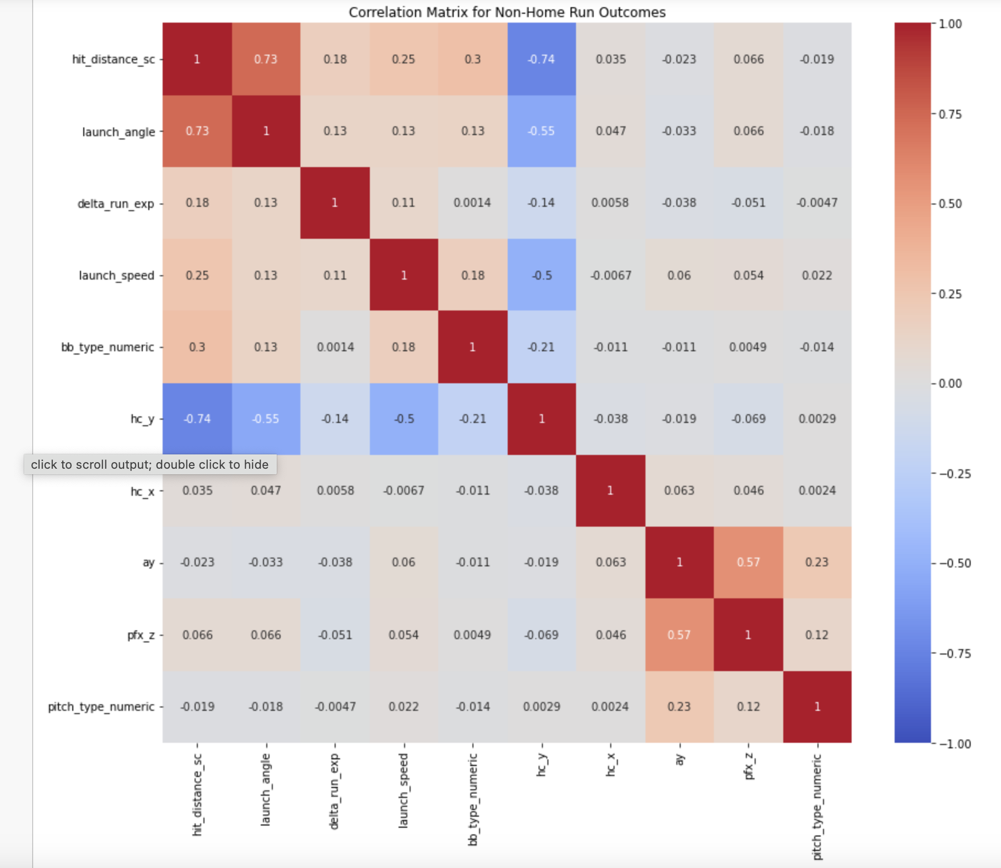
Examining Features for Signs of Multicollinearity
Examined correlation matrix for 10 most important features for both home runs and non-home runs
For non-home runs (most notable correlations):
Launch_angle & hit_distance = 0.73
hc_y & hit_distance = -0.74
hc_y & launch_angle = -0.55
hc_y & launch_speed = -0.50
ay & pfx_z = 0.57
For home runs (most notable correlations):
Launch_speed & hit_distance = 0.63
Launch_speed & hc_y = -0.79
Pfx_z & ay = 0.61

Slide 9
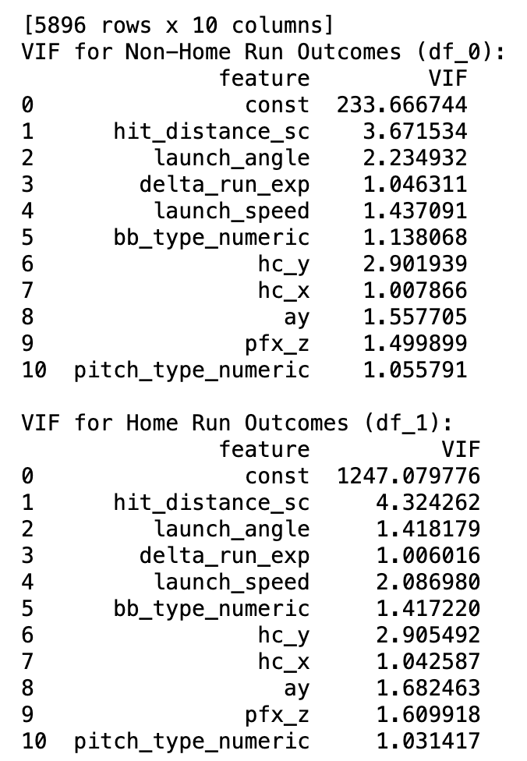
Examining Features for Signs of Multicollinearity Cont.
Checked VIF (Variance Inflation Factor) for all 10 features
For non-home run events:
Moderate correlation detected (3.67 for hit_distance, launch_angle = 2.23, hc_y = 2.90)
For home run events:
Again, moderate correlation noted (4.32 for hit_distance, hc_y = 2.90)
Decided to keep both hit_distance and hc_y as features (did not capture the same data upon examination)

Slide 10
Model 1: Logistic Regression on 10 Features
Initially implemented logistic regression based on 10 most important features mentioned earlier (x) to predict class labels (y)
Performed train_test_split with test size of 0.2 (standard test size)
Trained classifier on training set to generate predictions for X_test values
Generated model performance metrics & examined whether removing features would improve model performance
Ended up realizing multiple features had no impact on performance metrics (hc_x, ay, pfx_z, and pitch_type), so removed these
Also found that removing launch_speed improved TPR while PPV, F1 score, & AUC remained constant, so removed this feature
Remaining features were hit_distance, launch_angle, delta_run_exp, & hc_y

Slide 11
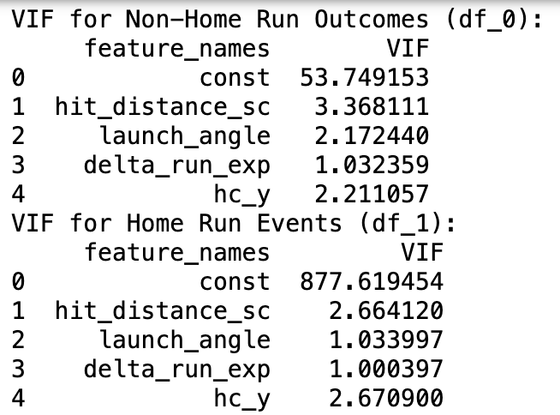
Re-Examining 4 Most Important Features for Multicollinearity
First examined VIF values now that 6 features removed from analysis
For non-home runs:
Hit_distance = 3.37, launch_angle = 2.17, delta_run_exp = 1.03, hc_y = 2.21
For home runs:
Hit_distance = 2.66, launch_angle = 1.03, delta_run_exp = 1.00, hc_y = 2.67
VIF values dipped significantly for home run events, dropped slightly for non-home run events
Indicates slight correlation between hit_distance, launch_angle, and hc_y, but this is weak
Also indicates that value most predictive of home runs = hit_distance

Slide 12
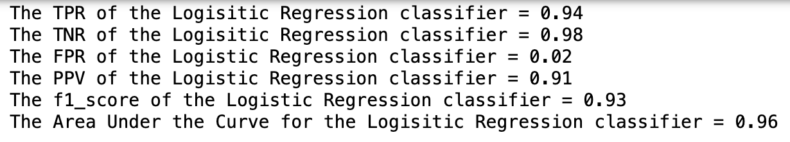
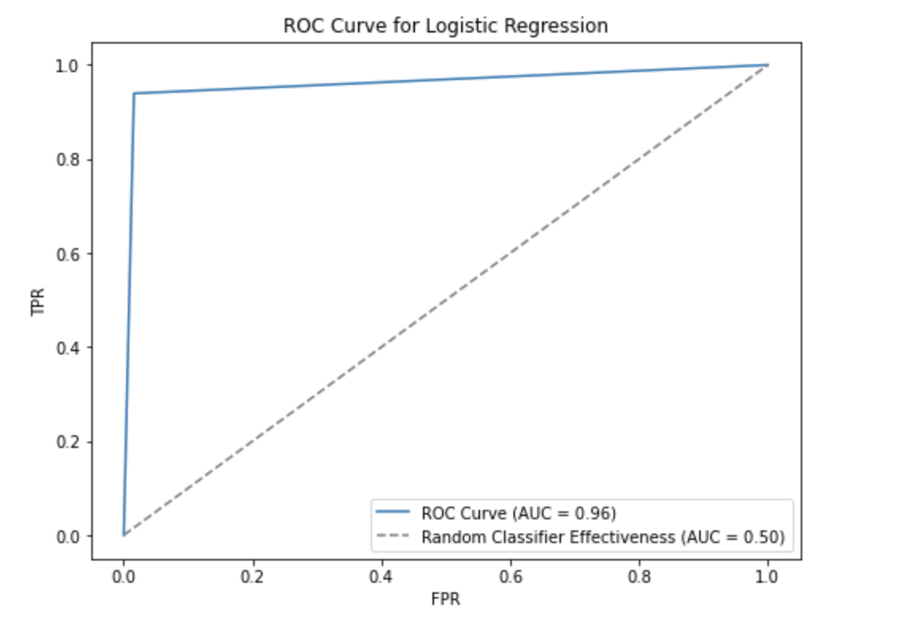
Optimal Model 1: Logistic Regression using 4 Features
Trained logistic regression classifier on hit_distance, launch_angle, delta_run_exp, & hc_y (X) to predict class labels (y)
Performed train_test_split with test size of 0.2
Trained classifier on training set to generate predictions for X_test values
Performance metrics:
TPR = 0.94, PPV = 0.91, f1_score = 0.93, AUC = 0.96

Slide 13
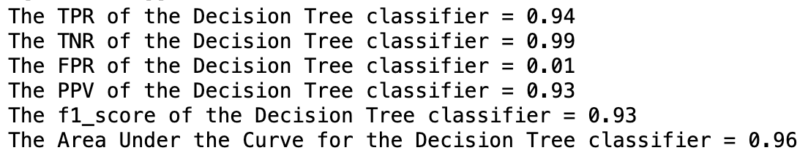
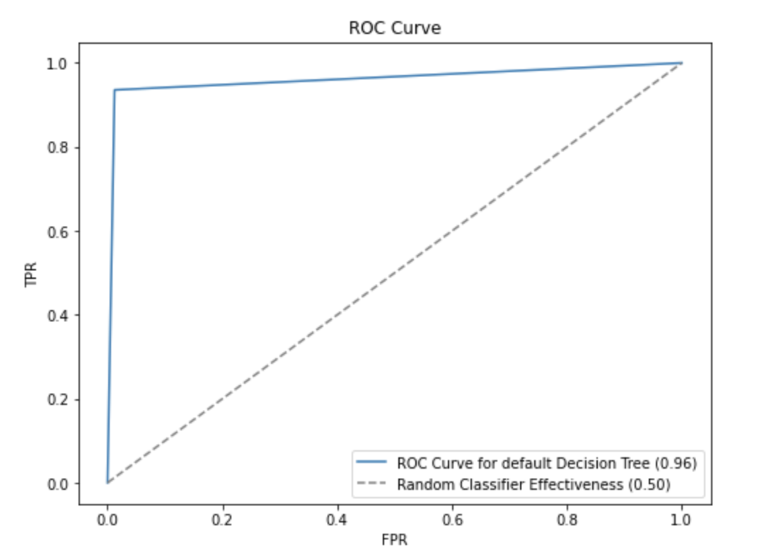
Model 2: Default Decision Tree Classifier
Generated new random train_test_split of data using same test size
Used Decision Tree based on entropy
Trained classifier on training data to generate predictions for y_test from X_test
Performance metrics for default Decision Tree:
TPR = 0.94, PPV = 0.93, F1 score = 0.93, & AUC = 0.96

Slide 14
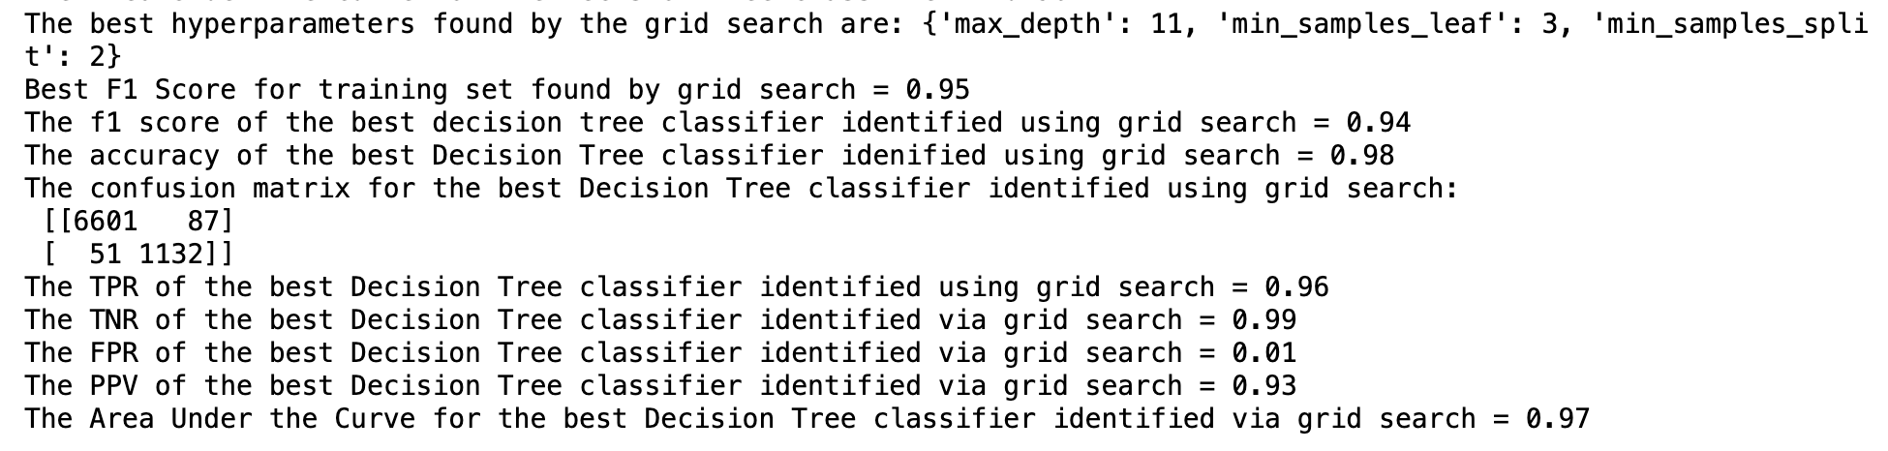
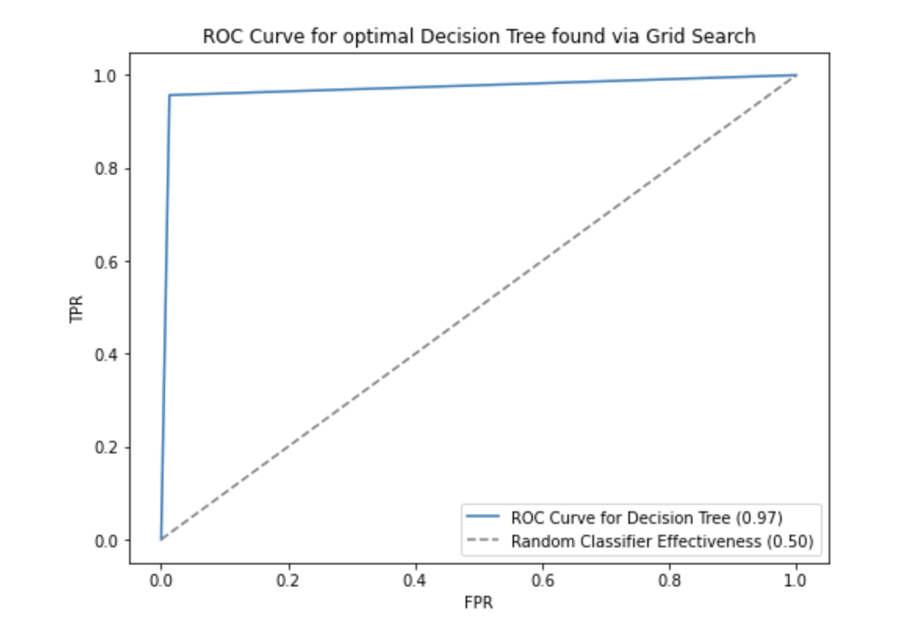
Optimizing Hyperparameters for Decision Tree
Ran six different experiments using Grid Search to find optimal hyperparameters for Decision Tree
Used 5-fold cross validation and F1 Score as the metric to evaluate model performance
Hyperparameters focused on = max_depth, min_samples_leaf, and min_samples_split
After running these experiments, best hyperparameters were:
max_depth = 11, min_samples_leaf = 3, min_samples_split = 2
When running a Decision Tree using these hyperparameters, performance metrics were:
TPR = 0.96, PPV = 0.93, F1 Score = 0.94, & AUC = 0.97

Slide 15
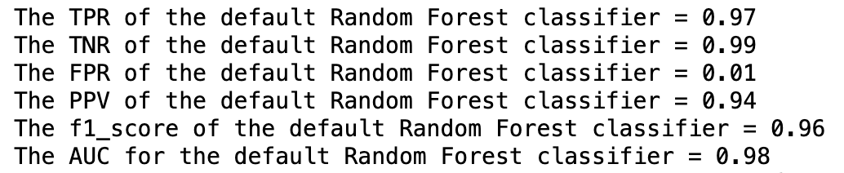
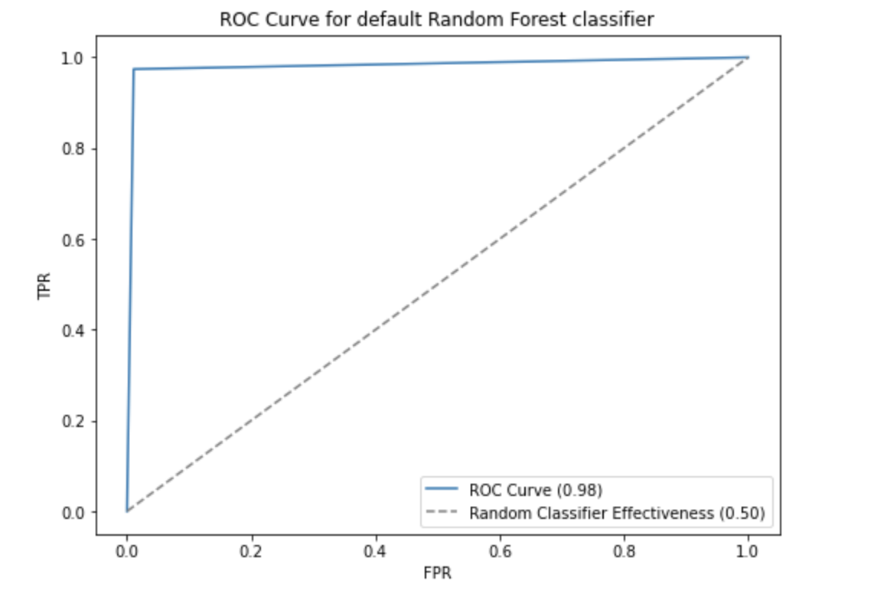
Model 3: Random Forest
Generated different train_test_split using same test size
Used default Random Forest based on Entropy
Trained classifier on training data to generate predictions based on X_train
Performance metrics for default Random Forest:
TPR = 0.97, PPV = 0.94, F1 Score = 0.96, AUC = 0.98

Slide 16
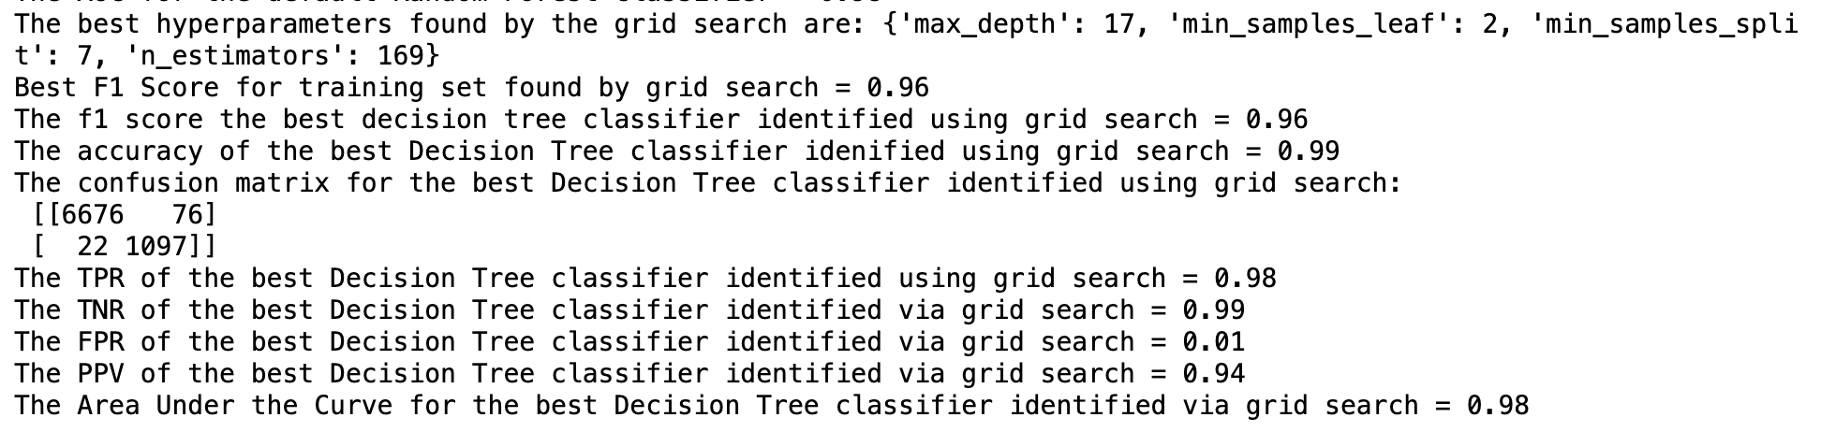
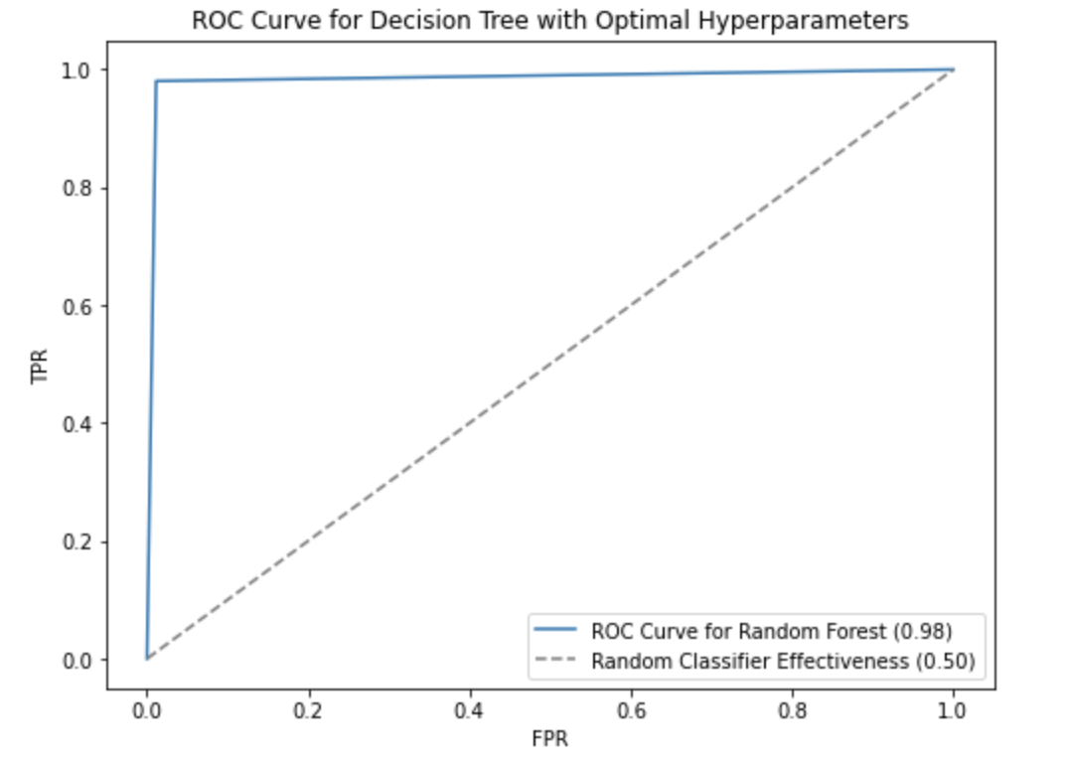
Optimizing Hyperparameters for Random Forest
Ran experiments using Grid Search to find optimal hyperparameters
Used 5-fold cross validation and F1 Score as metric to evaluate model performance
Hyperparameters that were optimized = max_depth, min_samples_split, min_samples_leaf, and n_estimator
After running 9 different experiments, optimal hyperparameters were:
Max_depth = 17, min_samples_split = 7, min_samples_leaf = 2, & n_estimators = 169
When running Random Forest using these hyperparameters, performance metrics were:
TPR = 0.98, PPV = 0.94, F1 Score = 0.96, & AUC = 0.98

Slide 17
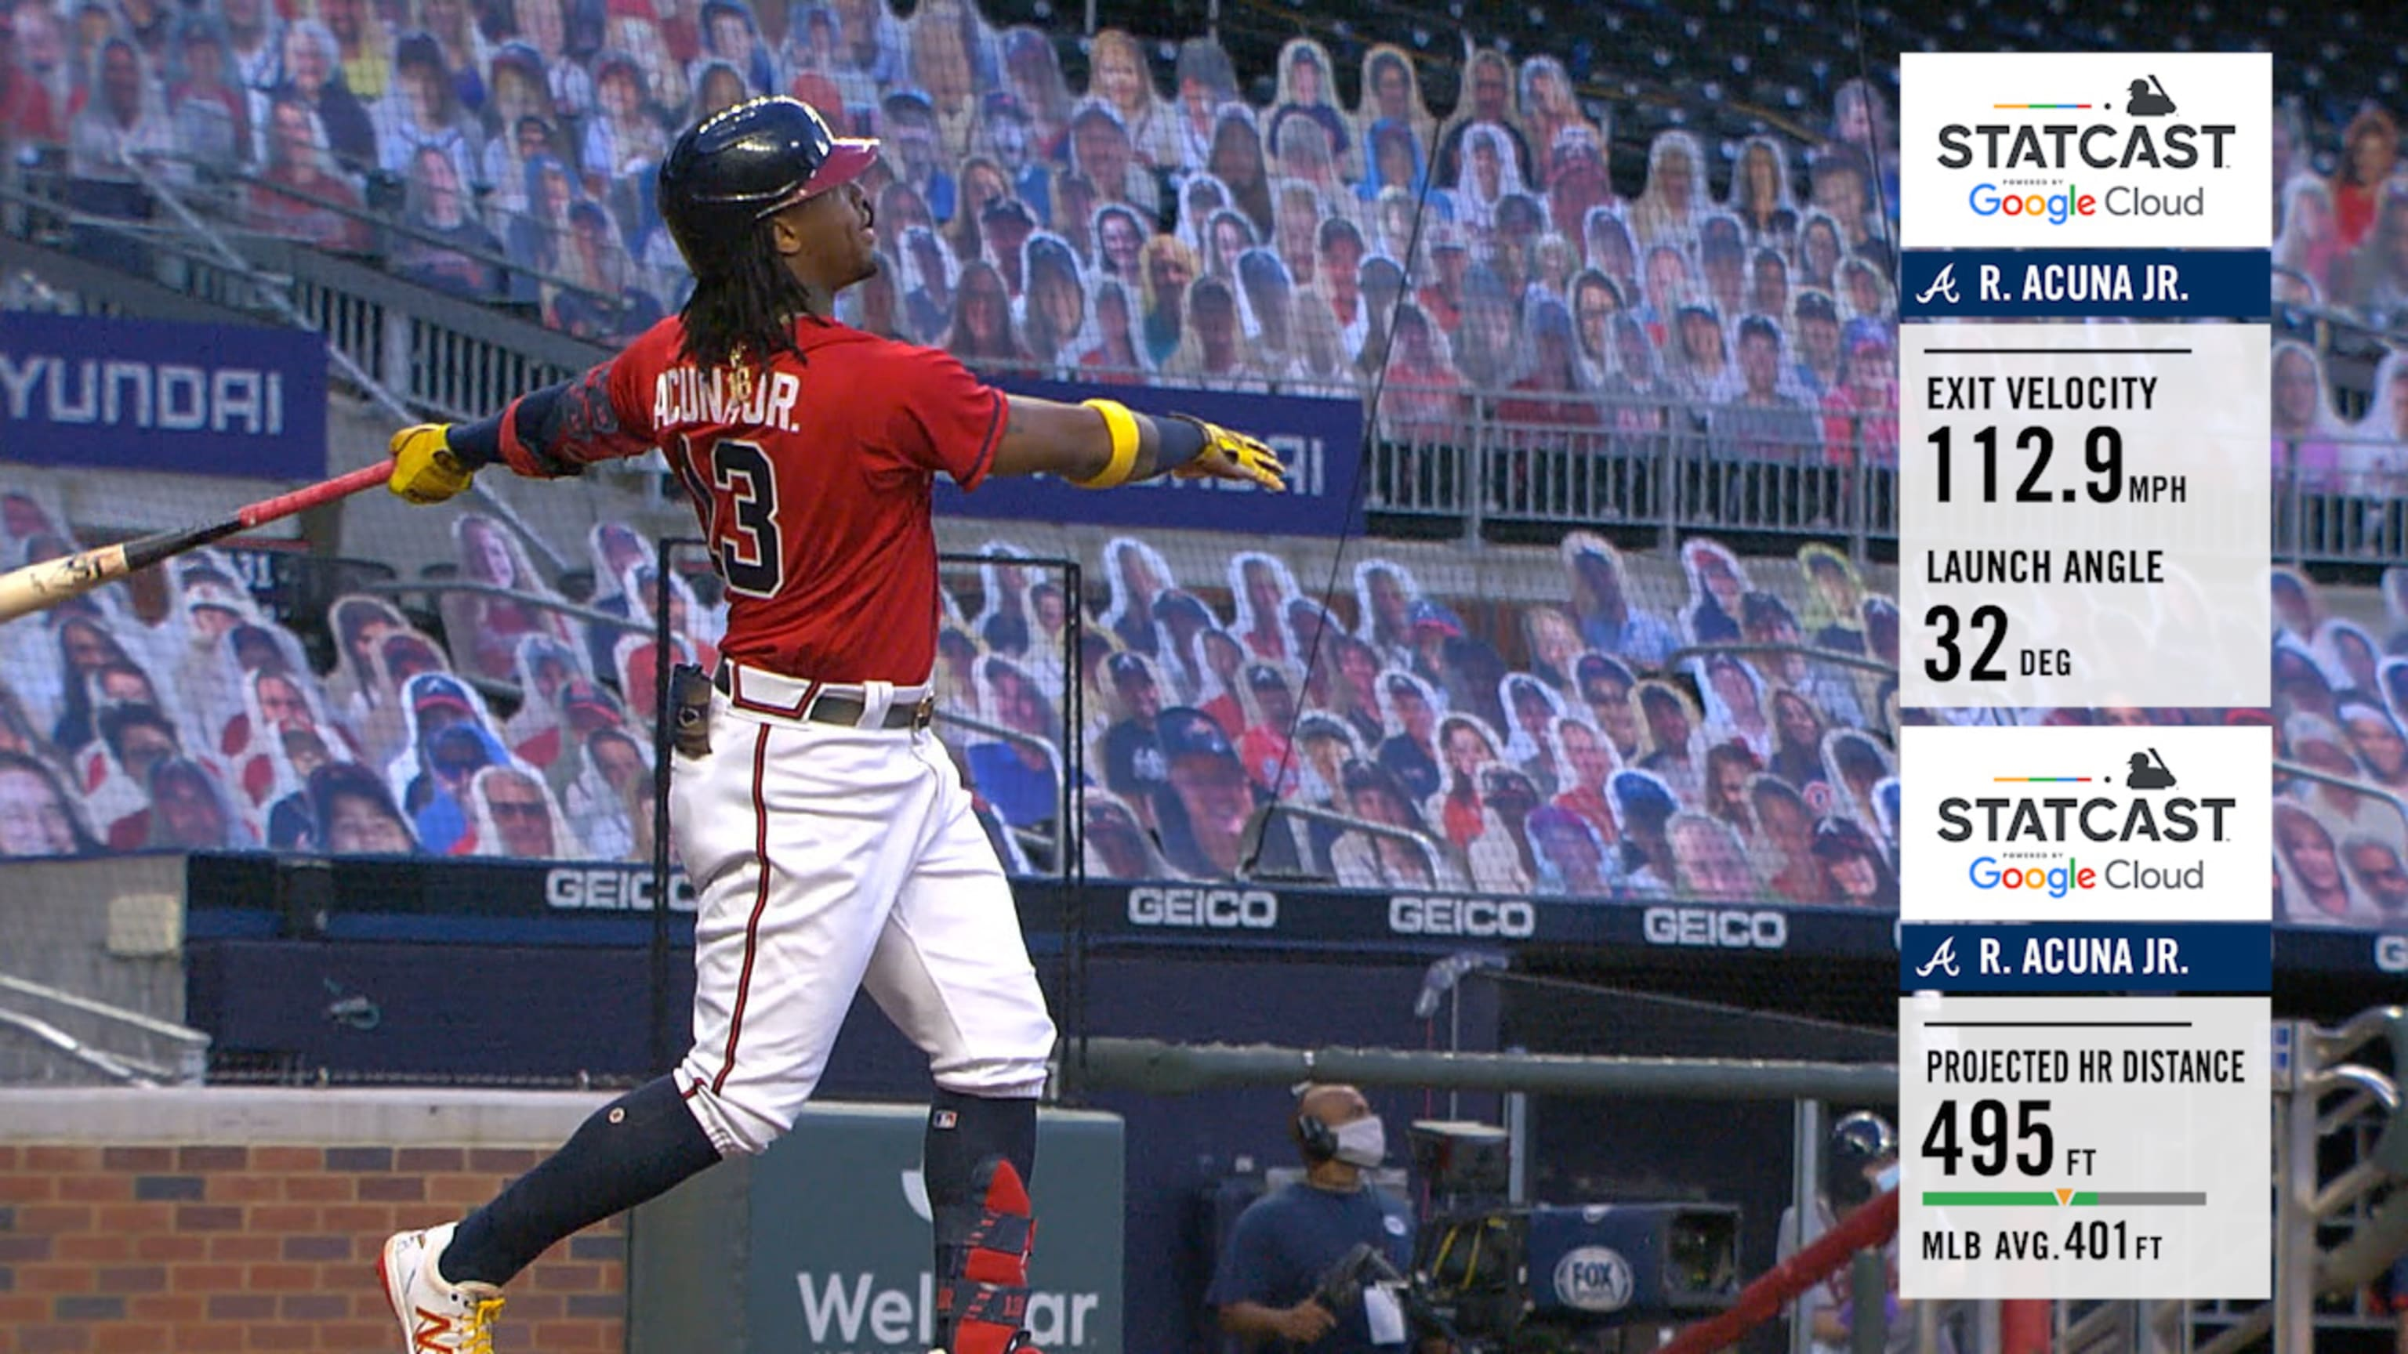
Key Takeaways
Model which identified home run events best = Random Forest
Model with highest PPV = Decision Tree & Random Forest
Model with highest F1 Score = Random Forest
Model with AUC score = Random Forest
Model that performs best over each performance metric = Random Forest
Features used (hit_distance, launch_angle, delta_run_exp, & hc_y) were very accurate at differentiating between home run events and non-home run events across each classifier
There is a somewhat linear relationship between hit_distance, launch_angle, and hc_y

Slide 18

Challenges Faced
Biggest challenges were:
Figuring out what features to use/remove from analysis
Determining if multicollinearity was truly present
Figuring out how to handle NA values
Finding the optimal hyperparameters for Decision Tree and Random Forest
Determining how to evaluate model performance

Slide 19
Recommendations
Further examination of interaction between hit_distance, launch_angle, & hc_y to see if they might be collinear despite not capturing the same data
Running further experiments to see if other hyperparameter values lead to even better performance
Testing other ML models to see if they yield more accurate results
Using only during event data to predict home run outcomes versus post-event data
Incorporating other features not accounted for in this analysis such as stadium or weather-related features into analysis
Performing similar analysis using only pitching data to determine home run outcomes
Multiple possible extensions based on findings

Slide 20
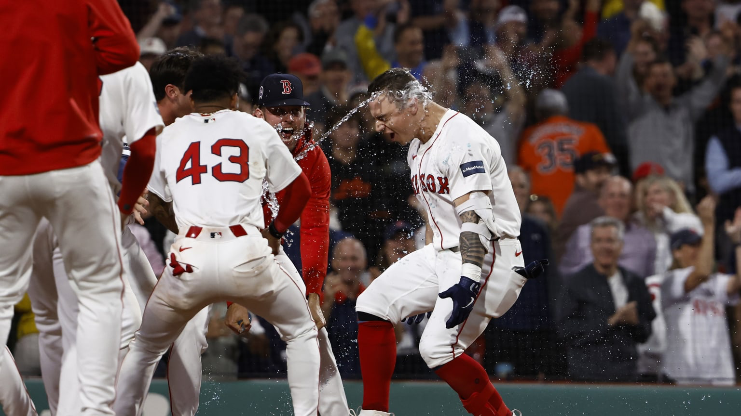
Thank You!

